Slide 1

Basic Principles of Computed Tomography Physics
Presented by
Dr. Intesar El Mesady

Slide 2

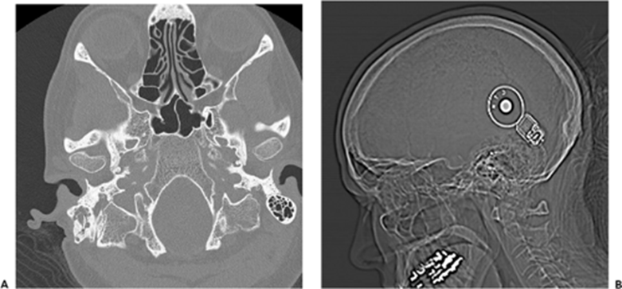
Conventional radiography
an x-ray beam is generated and passed
through a patient to a piece of film or a
radiation detector
producing an image in 2D
Fig. 1 A: X-ray and B: Computed tomography of head with cochlear implant
A computed tomography (CT)
a series of X-rays taken from different angles
assembled into a 3D model by a computer
useful for understanding blood vessels and soft tissue
metal (white, or radiopaque), bone cortex (less white), muscle and fluid (gray), fat (darker gray), and air or gas (black, or radiolucent)

Slide 3
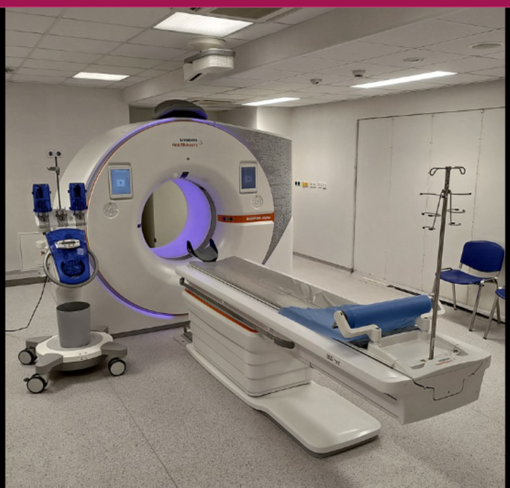
INTRODUCTION
C T
Computed Tomography
Tomography
Tomo + Graphy
Picture To write

Slide 4
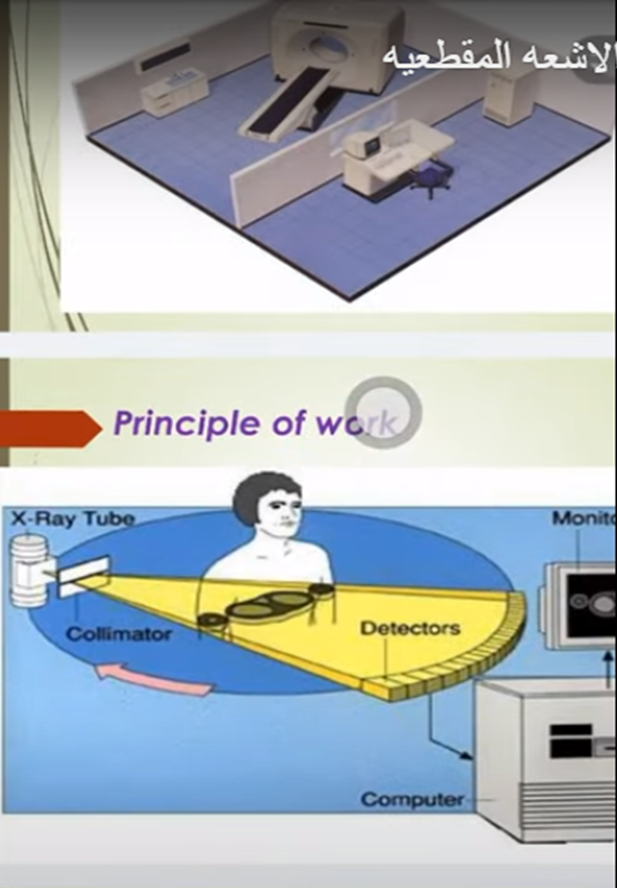
CT ACQUISITION SYSTEM COMPONENTS
The generator
The scanning unit (gantry),
which includes one or more
X-ray tubes
Photon detectors
Shielding elements
The patient table
The image processor
The console (control unit)

Slide 5
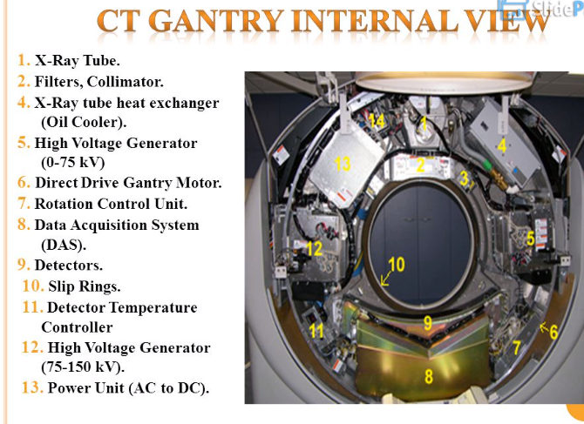

Slide 6
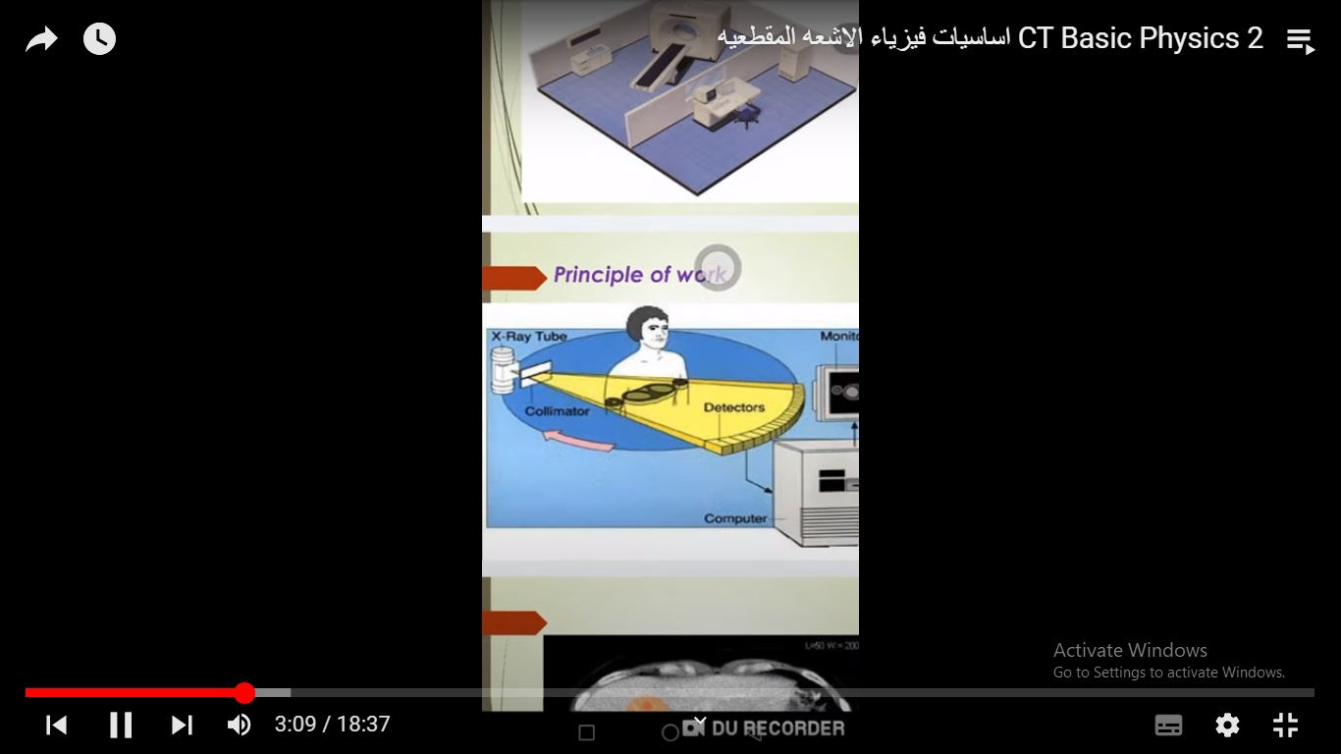
Principle of work
* For medical imaging, x-rays are generated
by an x-ray tube
* CT scanner uses a motorized x-ray source that rotates around the circular opening of a donut-shaped structure called a gantry
* During a CT scan, the patient lies on a bed that slowly moves through the gantry while the x-ray tube rotates around the patient, shooting narrow beams of x-rays through the body
* CT scanners use special digital x-ray detectors, which are located directly opposite the x-ray source
* x-rays leave the patient, they are picked up by the detectors and transmitted to a computer

Slide 7
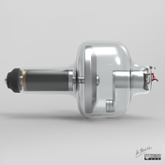
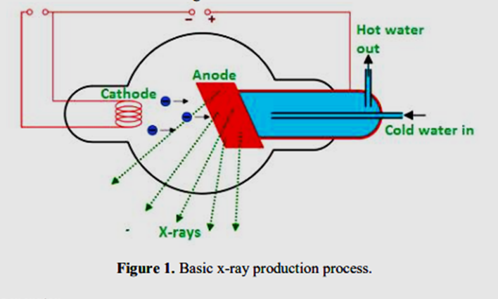
Generation of X-Rays
An x-ray tube functions as a specific energy converter, receiving electrical energy and converting it into two other forms of energy: x-radiation (1%) and heat (99%)
The x-ray tube contains two principal elements:
filament (also acts as cathode): boils off electrons
by thermionic emission
2. target (also acts as anode):
electrons strike to produce x-rays
Additional components include:
expansion bellows (provide space
for oil to expand)
tube envelope (evacuated)
tube housing
cooling dielectric oil
rotor
induction stator
tube window: usually made from beryllium, not glass

Slide 8
For X-ray technique and X-ray analysis radiolucent windows are needed in many cases.
These windows can work as a transparent gas barrier for X-ray tubes and detectors for example.
Because of the highly Z-dependent absorption of X-rays, especially at low energies, it is necessary that the window is made of low atomic number materials and low thicknesses.
At this beryllium has a special position in the periodic table. It is one of the light metals and nevertheless it has a remarkably high melting point and a significantly higher young´s modulus than steel.
Thus, it is possible to manufacture Be-windows with thicknesses of 100-8 microns, which will withstand the load of the air pressure against the vacuum.

Slide 9
Cathode
Filament
Made of thin (0.2 mm) tungsten wire because tungsten:
  has a high atomic number (A 184, Z 74)
  is a good thermionic emitter (good at emitting electrons)
  can be manufactured into a thin wire
  has a very high melting temperature (3422°c)
The size of the filament relates to the size of the focal spot. Some cathodes have two filaments for broad and fine focusing
Anode
Target made of tungsten for same reasons as for filament
Rhenium added to tungsten to prevent cracking of anode at high temperatures and usage
Set into an anode disk of molybdenum with stem
Positively charged to attract electrons
Set at angle to direct x-ray photon beam down towards patient. Usual angle is 5º – 15º

